Slide 1

HR ANALYTICS DASHBOARD by:
Shubh Jalui,
Sarvesh,
Tarun &
Janani
Source: Kaggle

Slide 2
OUR AIM
Predict Key Trends
Analyze Employee Metrics
Enhance Data Accuracy
Visualize Insights
Identify factors influencing attrition and derive predictive insights for HR decision-making.
Transform HR data into actionable insights to improve employee satisfaction and retention.
Clean, preprocess, and structure data to ensure relevance and quality for meaningful analysis.
Create interactive dashboards for real-time exploration of workforce dynamics and trends.

Slide 3
Data Description
Dataset Name: HR Employee Atrrition
Total Records | 1470 Rows, 35 Columns
Key Features | Demographics for Age, Gender, Marital Status
Job Details | Department, Job Role & Job Level
Performance Analysis | Attrition, Monthly Income & Years at Company
Personal influence | Distance from home for employee & Employee Satisfaction score
Agenda | Analyze factors influencing employee attrition

Slide 4
PROCESS FLOW
01
02
03
04
05
Data Collection & Understanding
Using this as the source from Kaggle we understand it is for HR Analytics Employee Attrition & Performance
.
Data Preprocessing
Loading the dataset into Power BI, understanding and Handling the data
Data Transformation
Cleaning and transforming the data as well as creating new columns for calculated values.
Data Visualization
Creating the visualizations after the transformation to try and interpret the data.
Data Interpretation
Creating meaningful insights from the data from looking at the visualizations.

Slide 5
Overview of Attrition
01
02
03
Employee Attrition Prediction
Workplace Satisfaction Analysis
Workload Optimization
Identifies employees likely to leave to reduce turnover.
Measures satisfaction across key metrics for improvement.
Highlights how workload impacts retention and performance.
04
05
06
Promotion Delay Insights
Salary Alignment Trends
Visual Dashboards
Uncovers the role of delayed promotions in dissatisfaction.
Analyzes salary disparities impacting engagement and equity.
Provides intuitive visualizations for HR decision-making.

Slide 6
Requirements by the HR
Reduce Turnover Rates:
Identify and address factors driving employee attrition to retain top talent.
Enhance Employee Satisfaction:
Analyze metrics to improve engagement and workplace environment.
Data-Driven Decisions:
Utilize actionable insights for optimizing promotions, workload, and compensation policies.
Problems faced by the HR:
High turnover rates increasing recruitment and training costs.
Lack of actionable insights for retaining key employees effectively.
Difficulty in tracking satisfaction, workload, and promotion impacts on attrition.
Misalignment between employee performance and compensation structures.
Challenges in identifying and addressing dissatisfaction early to prevent attrition.

Slide 7
Dealing with Data
Removal of observations with no specific insight.
Making Structural Changes without error
Managing unwanted outliers
Handling missing data

Slide 8
Preprocessing
Job Jumper Flag
Overall Score
To check for employees who change companies frequently
An overall score with the involvement & rating of the employee
Employee Status
Personal Satisfaction
To see if the employee is a formal or an active.
A column created to check an employees satisfaction with the company

Slide 9
Preprocessing
Variable Rate
An adjusted rate for employee with respect to the companies revenue
Experience at Company
An employee’s status with respect to his term at the company
Stock Compensation Level
A prediction of stock value for an employee’s salary
Travel Burden
A prediction of issues for employees with respect to travel distance

Slide 10
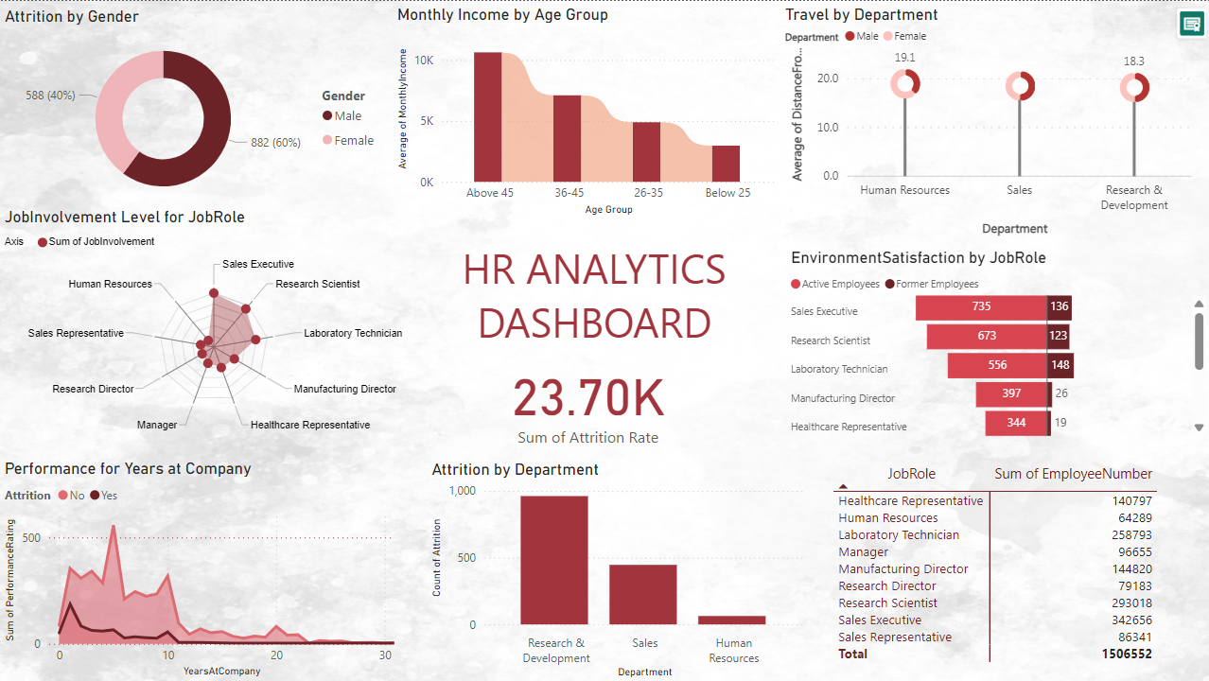
Visualizations

Slide 11
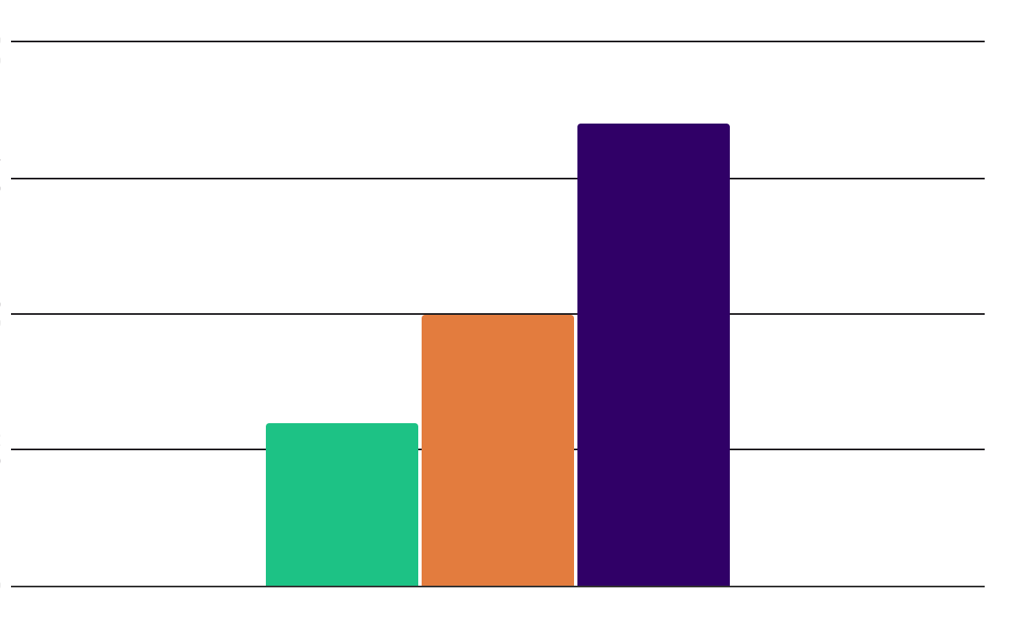
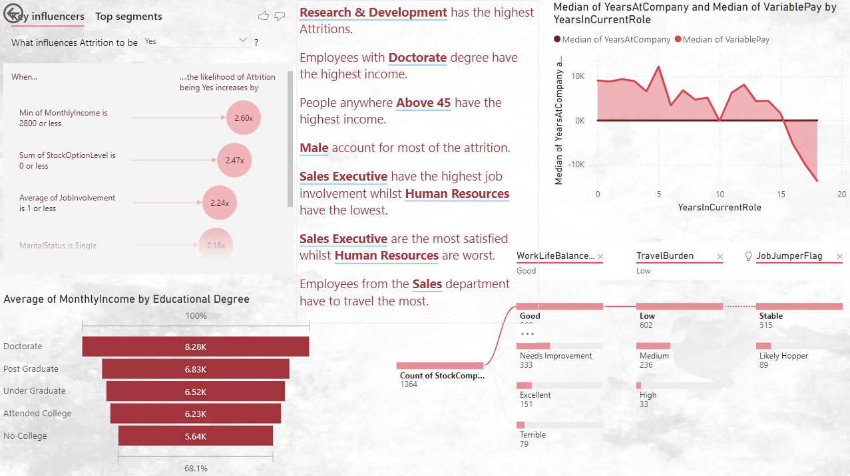

Slide 12
Results & Analysis
Highlighted the impact of delayed promotions on employee dissatisfaction and attrition.
Identified roles and departments with the highest attrition rates, enabling focused retention efforts.
Showed trends in performance relative to compensation, supporting equitable policy adjustments.
Provided actionable insights to balance work-life satisfaction across demographics and departments.

Slide 13
THANK YOU!

